Slide 1

Road crashes and casualties in South Australia.

Slide 2
Outline
Proposal
Research Questions
Dataset Description
Team Introduction
Motivation
Problem Statement

Slide 3






Team Introduction
Harpreet Singh
Raminder Singh
Komal
Group - 9
Section 003
Rachna
Nobin Ann Mathew

Slide 4

Road accidents are happening most often everywhere which is a serious concern. The main causes of Road traffic accidents is reckless and speedy driving of vehicles, overcapacity hauling of public vehicles, poor maintenance of road or vehicle. The goal of this study is to initiate road safety rules in South Australia by addressing and study on Road accidents. The project involve in depth study of Crash, Casualty and unit of year 2018. Our efforts are to determine the reasons of occurrence of accidents from the data which is available to us.
Background / Motivation

Slide 5
For the safety of general public and to save millions of lives, it is very important to understand the factors are responsible for road accidents. These factors include weather conditions, potholes, daylights, reckless driving, drunk and drive, ignorance of road safety, over-speeding etc. Many public as well as private organizations are stepping up to reduce the number of road accidents. Road accidents not only have fatal outcomes, but it also costs a fortune to insurance companies and sometimes it adversely affects a vehicle manufacturing company’s reputation in the market. To keep up with the market, companies try to improve the safety feature of their vehicles. They use the road accidents data to identify the reasons of these accidents.
Problem Statement

Slide 6
Who will be benefitted
Public Welfare Organizations
To help in identifying accident prone zones and saving lives
Vehicle Manufacturing Companies
To add improved safety measures in their products
Insurance Companies
To decide appropriate insurance policies for its customers
Transportation Companies
To help in identifying best road routes to increase their profits

Slide 7

Proposal
We will be focusing on descriptive analysis and examine the different factors that are responsible for accidents and understanding the relationship between all factors. We will also try to check some of the common beliefs of people related to accidents like lights on the roads, safety precautions like helmet or seat belts, weather conditions, gender of the driver etc.

Slide 8

Research Questions
To check the myth that men are better driver than women.
Analyze the factor responsible for road accidents.
To analyze the road accidents according to age.
To analyze if weather conditions, day light and road surface have an affect on accidents severity.
What is the age distribution of drivers involved in the accidents.
To analyse if safety precautions are helpful.

Slide 9
Dataset Description
The analysis will be based on three datasets : casualty, crash and Units which is obtained from data.gov.au website.
These datasets included data for year 2018 .
The casualty dataset consists of 12 columns. Description of casualty dataset is given below:
Casualty number : A number assigned to a casualty within a unit involved in a road crash
Casualty Type : A code defining the entity injured in a unit in a road crash
Casualty Sex : A code defining the sex of a casualty injured in a road crash
Casualty Age : The age of a casualty injured in a road crash

Slide 10
Position in vehicle : A description of the position of a casualty in or on a unit involved in a road crash
Thrown Out : An indication of whether the casualty is thrown out of a unit as a result of a road crash
Injury Extent : A description of the severity of the injury sustained as a result of a road crash
Seat belt : An indicator of the casualty's seat belt usage in a road crash
Helmet : An indicator of the casualty's helmet usage in a road crash
Hospital : The name of the hospital where a casualty is treated or admitted
Report ID : Unique number assigned to records to separate individual crashes
Unit Number : A number assigned to a unit involved in a road crash
The crash dataset contains 30 columns. Description of the dataset is given below:
Report ID : Unique number assigned to records to separate individual crashes
Stats Area : A code defining whether the road crash occurred within City, Metro or Country Area
Suburb : The Suburb that the crash occurred in
Postcode : The Postcode that the crash occurred in

Slide 11
Total Units : The total number of units involved in a road crash
Total Casualties : Total number of casualties (fatalities + treated injuries) as a result of a road crash
Total Fatalities : Total number of fatalities as a result of a road crash
Total Serious Injuries : Total number of people admitted to hospital with overnight stay as a result of a road crash
Total Minor Injuries : Total number of people treated by private doctor or treated at hospital but not admitted
Year : Year of Crash
Month : Month crash occurred
Day : The day of the week the crash occurred
Time : The reported time of the crash
Area Speed Limit : The speed limit at the time and location of the crash
Position Type : Identifying if a crash location was at an intersection or midblock

Slide 12
Horizontal Alignment : Defines the horizontal alignment of the road at the sight of the crash
Vertical Alignment : Defines the vertical alignment of the road at the sight of the crash
Other Features : Defines other relevant features of the crash site locations
Surface Type : Defines the road surface type at the crash location
Road Moisture : Defines the pavement surface moisture condition at the crash location
Weather : Defines the weather condition at the time and location of the crash
Light Conditions : The lighting condition at the time and location of the crash
Crash Type : Defines the road crash type
Unit Responsible : The number of the unit determined to be responsible for the road crash
Entity Code : A code defining the entity deemed to be responsible for the road crash
Crash Severity : Defines the road crash severity Decoded values: “3: SI” = Serious Injury, “2: MI”, = Minor Injury, “1: PDO” = Property Damage Only
Traffic Control : Defines the traffic control at the time and location of the road crash

Slide 13
DUI Involved : Involved if at least one controller in the crash recorded an illegal Blood Alcohol Concentration level
Drugs Involved : Involved if at least one controller in the crash tested positive for a prescribed drug
Unique Loc : A concatenation of the X and Y coordinate
X : The X coordinate of the crash when located
Y : The Y coordinate of the crash when located
The unit dataset has 12 columns. Description of the dataset are as follows:
Number of Casualties : The total number of casualties for a unit involved in a road crash
Vehicle Reg State : The state or Territory the unit is registered in
Unit type : A code defining the type of unit involved in a road crash
Vehicle Year : The year of manufacture of a vehicle
Direction of Travel : A code defining the direction of travel of a unit immediately prior the road crash

Slide 14
Unit sex : A code defining sex of the controller of the unit involved in road crash
Unit Age : The age of the controller of the unit involved in a road crash
License State : A code defining the state of issue of the license of the driver/rider
License Class : A code defining the class of the license held by the driver/rider
License Type : A code defining the level of license held by the driver/rider
Towing : A code defining if the unit was towing another unit
Unit Movement : A code defining movement of a unit immediately prior to the road crash
Number of occupants : A code defining the number of occupants in unit at the time of crash
Postcode : The residential postcode of the unit in a road crash
Rollover : Subsequent rollover of vehicle Fire
Fire : Vehicle caught fire at some stage in the crash
Unit Number : A number assigned to a unit involved in a road crash

Slide 15
Casualty
Crash
Units
Road Crash Data

Slide 16
Datatype Of Variables
casualty
Categorical Variables
Unique
Casualty Type
Sex
Position in vehicle
Thrown out
Injury extent
Seat belt
Helmet
Hospital
Numeric Variables
Report ID
Casualty number
Casualty Age
Unit Number

Slide 17
Categorical Variables
Crash
Numeric Variables
Suburb
Position Type
Local Government Name
Horizontal Alignment
Vertical Alignment
Other Features
Surface Type
Weather
Road Moisture
Light Conditions
Crash Type
Crash Severity
Traffic Control
Stat Area
Month
Day
Unique
Area Speed Limit
Postcode
Total Units
Total Casualties
Total Fatalities
Total Serious Injuries
Total Minor Injuries
Year
Time
Report ID
Unique Location
Unique Location of x coordinate
Unique Location of y coordinate

Slide 18
Units
Categorical Variables
Unique
Direction Of Travel
Unit Sex
License State
License Class
License Type
Unit Movement
Towing
Vehicle Reg State
Unit Type
Numeric Variables
Report ID
Unit Age
Number of Occupants
Postcode
Unit Number
Vehicle Year
Number of casualties

Slide 19


EDA

Slide 20
About the data
There are missing, incomplete and invalid records in all the three datasets.
Outliers are present in all the three datasets which will be treated at a later stage in Data Cleaning.
Yes, the data is segmented in many groups according to different categorical variables in the datasets like sex, moisture condition, position type, road surface etc.
Yes, the data is imbalanced. For example: most of observations of moisture condition variable belong to ‘not raining’ only a few belong to ‘raining’, same case is for road surface , license class etc.

Slide 21
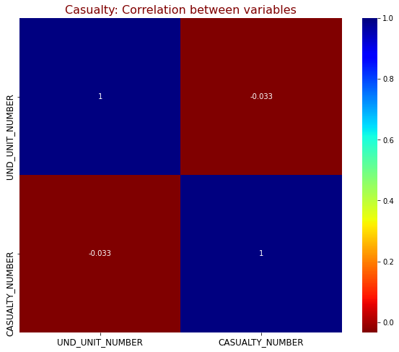
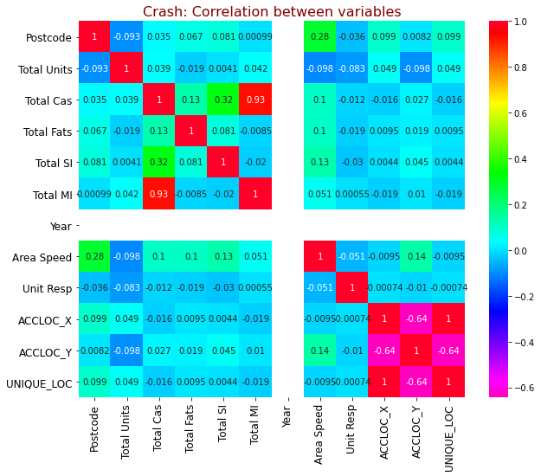
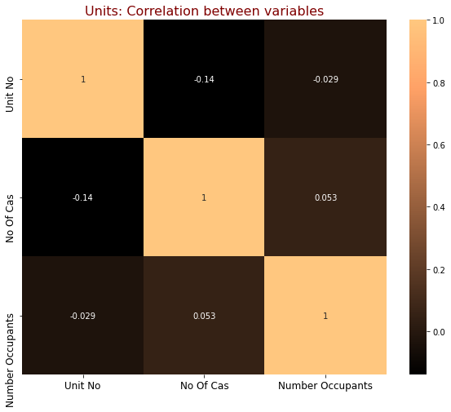
Exploring the Correlation
In the Casualty dataset:
There is weak linear relationship between the UND_UNIT_NUMBER and CASUALTY_NUMBER .
In the Crash dataset:
Total Cas and Total MI, ACCLOC_X and UNIQUE_LOC have strong positive linear relationship.
ACCLOC_X and UNIQUE_LOC have moderate negative linear relationship with ACCLOC_Y.
Other variables have weak linear relationship.
In the Unit dataset:
All the three variables have weak linear relationship.

Slide 22
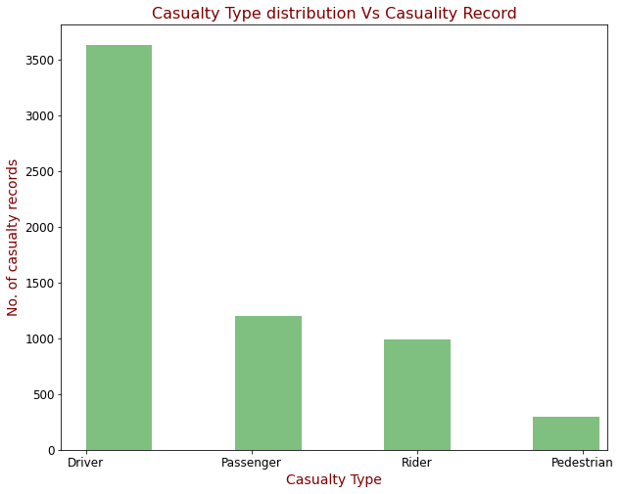
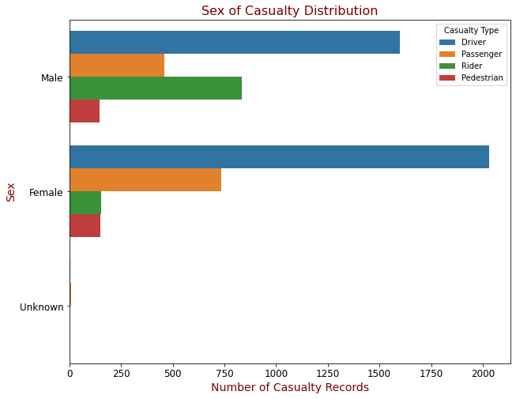
Casualty Dataset Visualizations
Visualization 1
Visualization 2
Maximum casualties were Drivers followed by Passengers, while minimum were Pedestrians.
Female Driver and Passenger casualties were more as compared to Male. But in case of Riders, Male casualties were more than Females.

Slide 23
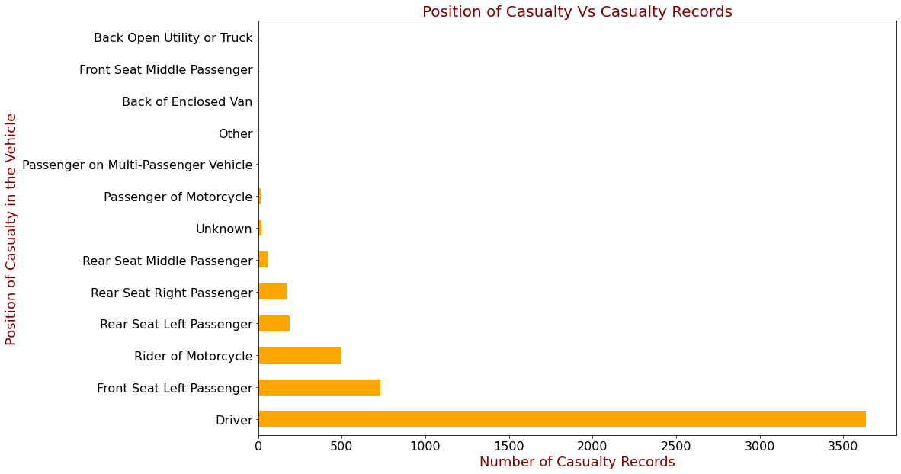
Visualization 3
Driving Seat had maximum number of Casualties. The second most casualties were in front seat left passenger. The data shows that among the rear seats minimum casualties were in Middle seat.

Slide 24
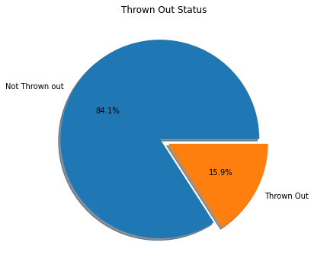
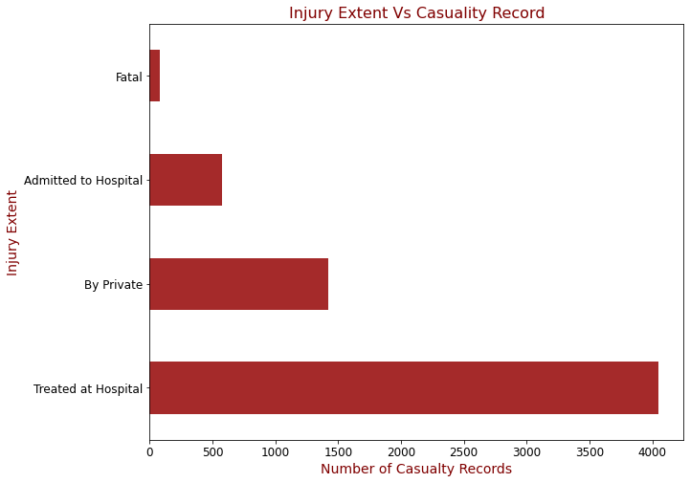
Visualization 4
Visualization 5
Only 15.9% of the casualties were thrown out of the vehicles.
Most of the casualties were treated at hospital. Some casualties were handled by Private and admitted to Hospital. Only a few were fatal.

Slide 25
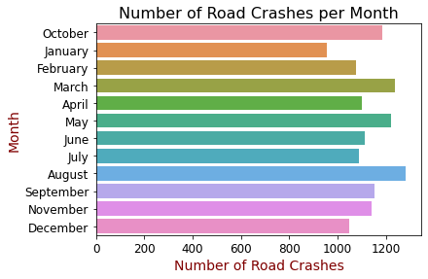
Crash Dataset visualization
Visualization1:
Maximum number of road crashes happened in August. March, May and October also had high number of crashes. Minimum road crashes were recorded in January.

Slide 26
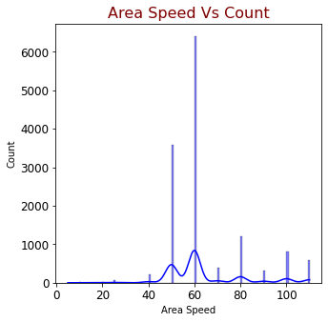
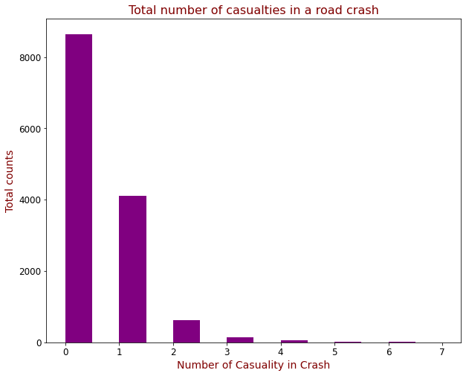
Visualization2:
Visualization3:
In most of the crashes, the number of casualties lies between 0-1. As the number of casualties increase, the number of crashes (total counts) decrease.
With area speed less than 40, the number of casualties are also less as compared to others. At speed 60 most of road crashes were recorded.

Slide 27
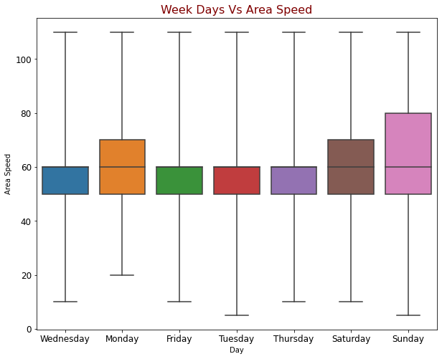
Visualization4:
The highest Area speed were recorded on Sunday followed by Saturday and Monday. On the remaining days, area speed lies between 50- 60 mostly.

Slide 28
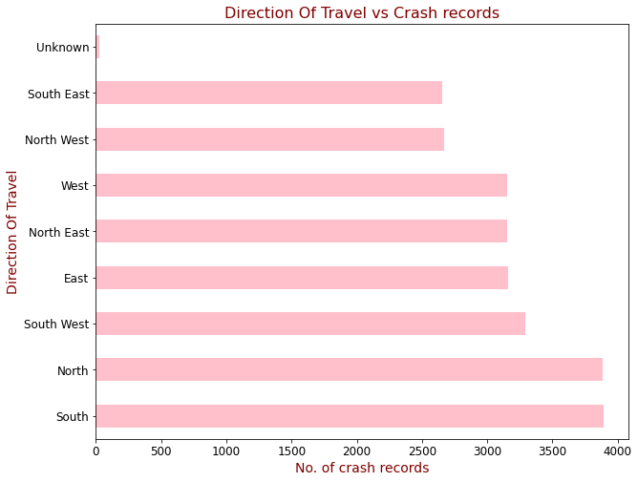
Unit Dataset Visualizations
Visualization 1:
Maximum number of crashes were recorded when the vehicle was moving in North and South direction, while minimum number of crashes were noted in South East and North West direction.

Slide 29
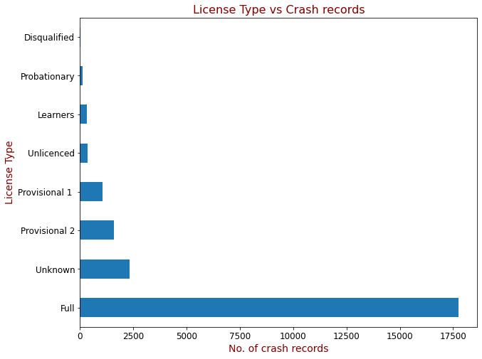
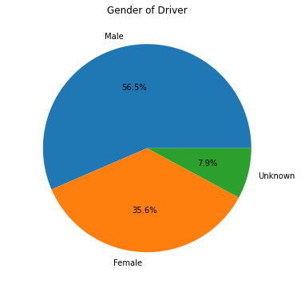
Visualization 2:
Visualization 3:
The full license type had the maximum number of crash records whereas probationary license type had minimum number of crash records.
56.5% of the drivers involved in a crash were Male and 35.6% were Female

Slide 30

In the data transformation:
We will be merging the datasets and will clean the data by removing the null values and outliers identified.
We will be renaming the columns, if needed.
We will also remove duplicate or redundant values identified in EDA.

Slide 31
GitHub Repository & Dataset link
GitHub Repository:
https://github.com/Kome28/DAB_103/blob/main/DAB_103.ipynb
Dataset link:
https://data.gov.au/dataset/ds-sa-21386a53-56a1-4edf-bd0b-61ed15f10acf/details?q=

Slide 32
References
https://cdn.pixabay.com/photo/2018/02/24/17/31/silhouette-3178687_640.png
https://cdn.pixabay.com/photo/2016/03/05/11/33/old-books-1237619_960_720.jpg
https://bovaryscomplaint.com/wp-content/uploads/2019/04/image-2.jpg
https://in.pinterest.com/pin/626915210602043222/

Slide 33

Thank you

